Slide 1

Capstone Project

Slide 2
LIVE STREAM
Agenda:
Work through Capstone Project Together
Q&A based on chat and Google Forms

Slide 3
Capstone Project
Let’s put all your current skills together with a fun Capstone Project!
This project takes us all the way back to 2015…
But before we begin, let’s quickly review our ML Pathway!

Slide 4

ML Pathway
Problem to Solve
How to fix or change X?
Real
World
Question to Answer
How does a change in X affect Y?

Slide 5
ML Pathway
Report
Visualization
Collect & Store
Data
Clean & Organize Data
Exploratory Data Analysis
Communication
Real
World
Data
Analysis
Make Decisions
Answer Key Questions

Slide 6
ML Pathway
Report
Jupyter Notebook + NumPy + Pandas + Matplotlib + Seaborn
Visualization
Collect & Store
Data
Clean & Organize Data
Exploratory Data Analysis
Communication
Real
World
Data
Analysis
Make Decisions
Answer Key Questions

Slide 7
Capstone Project
Question to Answer:
Is there a conflict of interest for a website that both sells movie tickets and displays review ratings?
Let’s travel back in time to the year 2015…

Slide 8
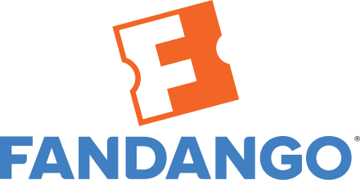
Capstone Project
2015
Fandango sells movie tickets online

Slide 9
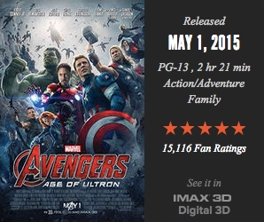
Capstone Project
2015
Fandango sells movie tickets online
Also displays movie ratings

Slide 10

Capstone Project
2015
You see Taken 3 has a 4.5 star rating on Fandango.

Slide 11
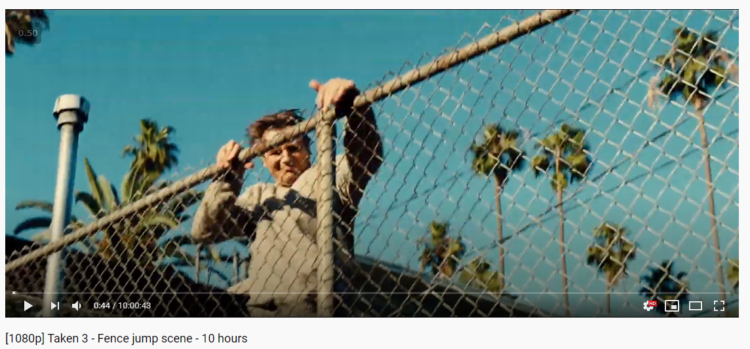
Capstone Project
2015
You may be disappointed by the film…

Slide 12
Capstone Project
2015
You begin to ask yourself…
Is there a conflict of interest for a website that both sells movie tickets and displays review ratings?
Can we answer this with data analysis?

Slide 13
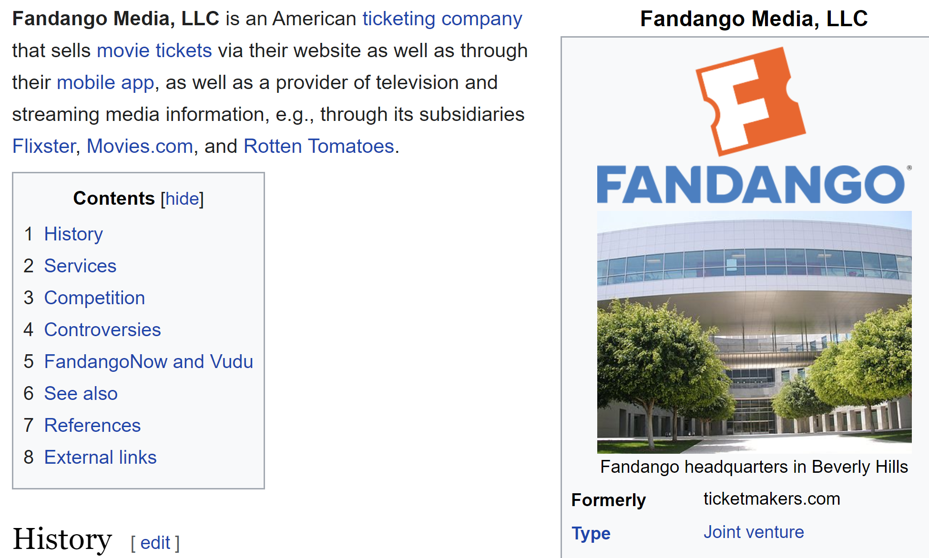
Capstone Project
Fandango

Slide 14
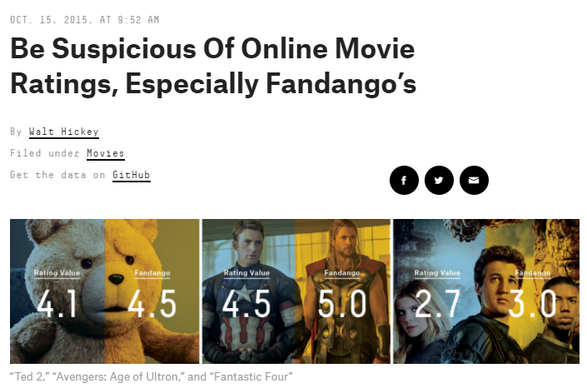
Capstone Project
The Capstone Project

Slide 15
Capstone Project
Question to Answer:
Is there a conflict of interest for a website that both sells movie tickets and displays review ratings?
More Specifically:
Does a website like Fandango artificially display higher review ratings to sell more movie tickets?

Slide 16
ML Pathway
Report
Visualization
Collect & Store
Data
Clean & Organize Data
Exploratory Data Analysis
Communication
Real
World
Data
Analysis
Make Decisions
Answer Key Questions

Slide 17
ML Pathway
Report
Visualization
Scrape Review Websites
Pandas to Organize
Use Seaborn to Explore
Communication
Real
World
Data
Analysis
Does Fandango display artificially higher than average reviews?

Slide 18
ML Pathway
Report
Visualization
Scrape Review Websites
Pandas to Organize
Use Seaborn to Explore
Communication
Real
World
Data
Analysis
Does Fandango display artificially higher than average reviews?

Slide 19
ML Pathway
Report
Visualization
Scrape Review Websites
Pandas to Organize
Use Seaborn to Explore
Communication
Real
World
Data
Analysis
Does Fandango display artificially higher than average reviews?

Slide 20
Capstone Project
Fandango has two ratings:
STARS
Rating in stars 0-5 displayed on their website’s HTML.
RATING
Actual true rating numerically shown on movie’s page.

Slide 21
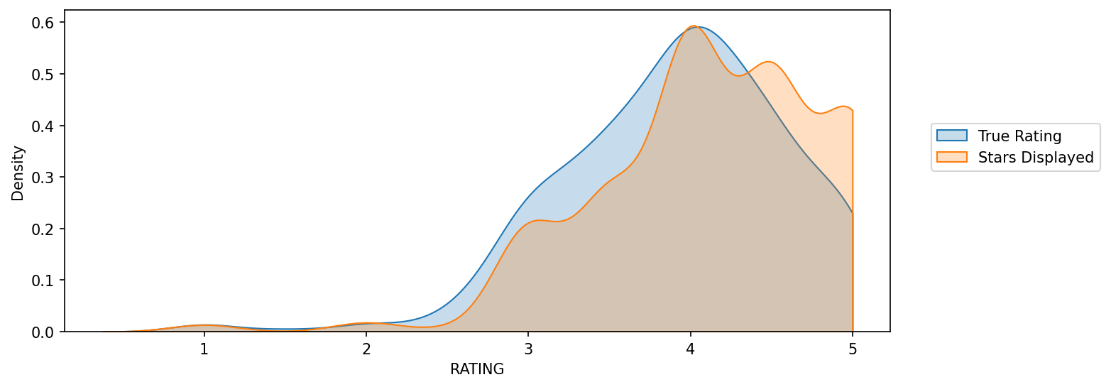
Capstone Project
Fandango has two ratings:
First we will compare these ratings to check for discrepancies.

Slide 22
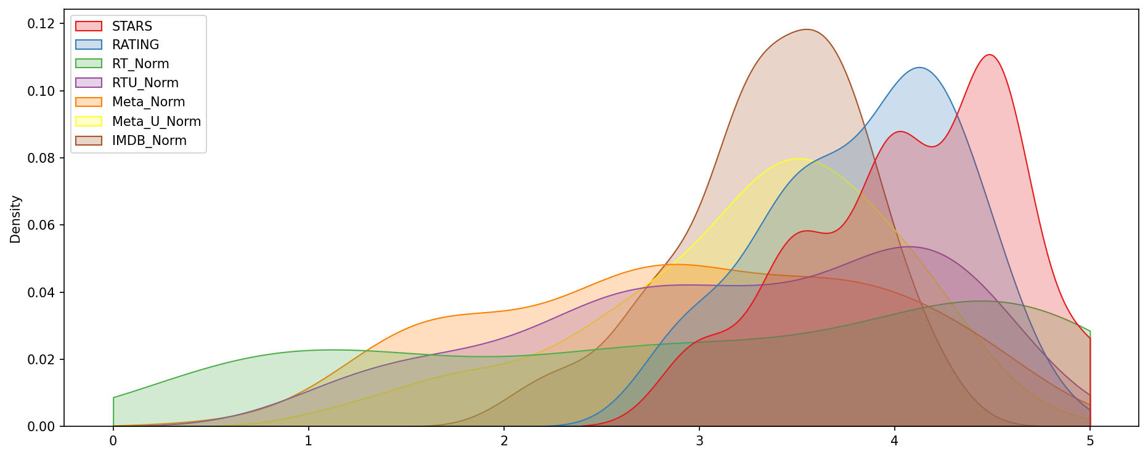
Capstone Project
Then we’ll compare Fandango’s ratings to other rating website scores:

Slide 23
Capstone Project
Let’s have an overview of the project exercise notebook!

Slide 24
Capstone Project Solutions - Part One

Slide 25
Capstone Project Solutions - Part Two

Slide 26
Capstone Project Solutions - Part Three

